Slide 1

Example questions NOIT
Team Pear
IankoVanov
IvanVidenov
dpesheva
Neda.Krasimirova
kameliq.rr
Georgimanov
IvoPN
SmileyFace
Dian_Atanasov

Slide 2
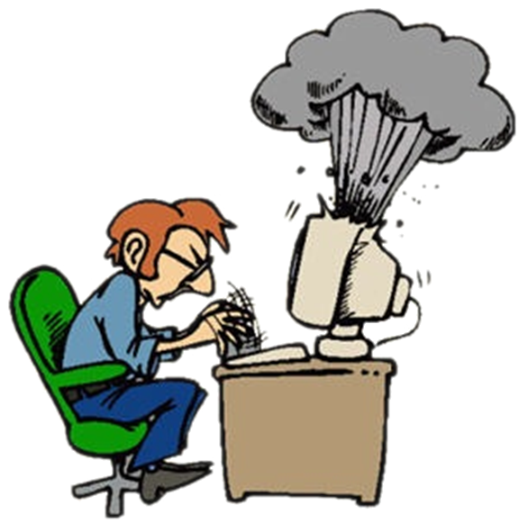

Computer Systems
Hardware

Slide 3
Question
Which of the following is active first during the normal PC boot process?
CMOS
RAM
HDD
ROM BIOS
CD-ROM

Slide 4
Answer
The boot order is the order of devices listed in BIOS that the computer will look for operating system information on.
http://www.webopedia.com/DidYouKnow/Hardware_Software/2004/BootProcess.asp

Slide 5


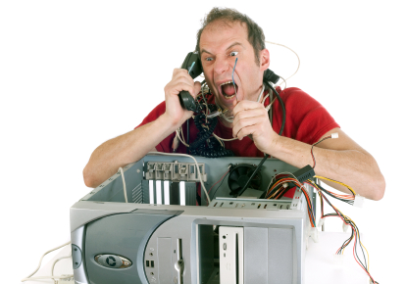
Computer systems and software
Installation, using, service, …

Slide 6
Question
What do you use to distribute applets over the World Wide Web?
JavaScript
Java
ActiveX
Dreamweaver
CGI script

Slide 7
Answer
Java is a computer programming language that is concurrent, class-based, object-oriented, and specifically designed to have as few implementation dependencies as possible. It is intended to let application developers "write once, run anywhere" (WORA), meaning that code that runs on one platform does not need to be recompiled to run on another. Java applications are typically compiled to bytecode (class file) that can run on any Java virtual machine (JVM) regardless of computer architecture. Java is, as of 2012, one of the most popular programming languages in use, particularly for client-server web applications, with a reported 9 million developers.
http://en.wikipedia.org/wiki/Java_%28programming_language%29

Slide 8
Work with computer systems and programs
Installation, use, maintenance, ...

Slide 9
Question
Msconfig >> Startup serves to:
Select programs to include at startup and which are not;
Delete programs;
Installing programs;
Find the programs you want to use now.

Slide 10
Answer
Utility system configuration (System Configuration) automate routine steps to troubleshoot used by specialists from the "Services Product Support" on Microsoft (Microsoft Product Support Services) in diagnosing problems with the system configuration.
Click the General ("General"), and then click Selective Startup ("Selective Startup"). You can select the files and settings you want to load when you restart your computer.
http://support.microsoft.com/kb/310560/bg

Slide 11

Data transfer and numeral systems
Database channels, tasks with numeral systems

Slide 12
Question
Which conversion from binary to octal is NOT true:
1001111₍₂₎ = 117₍₈₎
1001111₍₂₎ = 117₍₈₎
1001111₍₂₎ = 117₍₈₎
1001111₍₂₎ = 117₍₈₎

Slide 13
Answer
The binary number is divided into triads (from right to left) and from the table record the relevant octal numbers. Early in the binary bits are not enough to form a triad, it is filled with zeros.
http://tigertron.hit.bg/Bs.htm

Slide 14





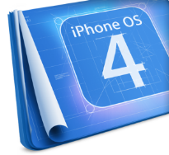








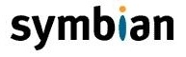
Operational systems
Architecture, processes, users, interfaces, file systems

Slide 15
Question
Which of the following file systems is used in OS X?
UFS
FAT
NTFS
ext2, ext3, ext4
HFS Plus

Slide 16
Answer
OS X uses a file system that it inherited from classic Mac OS called HFS Plus, sometimes called Mac OS Extended.
The Sun Microsystems Solaris operating system in earlier releases defaulted to (non-journaled or non-logging) UFS for bootable and supplementary file systems.
Linux supports many different file systems, but common choices for the system disk on a block device include the ext* family (such as ext2, ext3 and ext4).
Windows makes use of the FAT, NTFS, exFAT and ReFS file systems.
http://en.wikipedia.org/wiki/File_system#Space_management

Slide 17

Software engineering
Analysis, specification, design, prototype, implementation, testing, maintenance, ...

Slide 18
Question
Which of the following phases is the first step according to the waterfall development model?
Implementation
Requirements
Design
Verification

Slide 19
Answer
Requirements analysis: This first step is also the most important, because it involves gathering information about what the customer needs and defining, in the clearest possible terms, the problem that the product is expected to solve. Analysis includes understanding the customer's business context and constraints, and the external systems it must be compatible with. The results of the analysis are typically captured in a formal requirements specification, which serves as input to the next step.
http://en.wikipedia.org/wiki/Waterfall_model

Slide 20




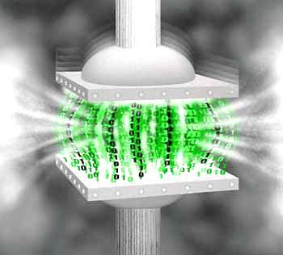




Compressing data
Compression algorithms, backup software

Slide 21
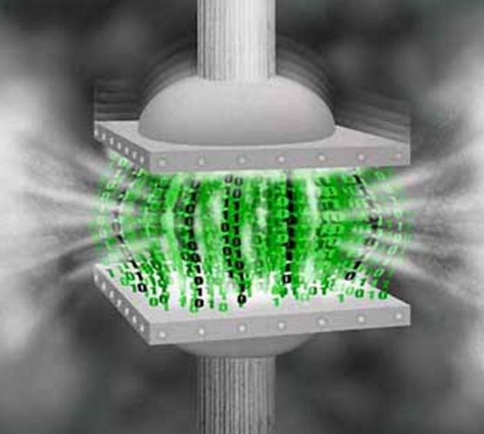
Question
Which of the following is a algorithm for lossless compression:
LZW
Opus
Microsoft Video 1
QuickTime Graphics

Slide 22
Answer
Lempel–Ziv–Welch (LZW) is a universal lossless data compression algorithm created by Abraham Lempel, Jacob Ziv, and Terry Welch. It was published by Welch in 1984 as an improved implementation of the LZ78 algorithm published by Lempel and Ziv in 1978. The algorithm is simple to implement, and has the potential for very high throughput in hardware implementations. It was the algorithm of the widely used Unix file compression utility compress, and is used in the GIF image format.
http://en.wikipedia.org/wiki/Lempel%E2%80%93Ziv%E2%80%93Welch
http://en.wikipedia.org/wiki/Opus_(codec)
http://en.wikipedia.org/wiki/Microsoft_Video_1
http://en.wikipedia.org/wiki/QuickTime_Graphics
http://en.wikipedia.org/wiki/Category:Lossy_compression_algorithms
http://en.wikipedia.org/wiki/Category:Lossless_compression_algorithms

Slide 23



Text editing
Working with text editing software, file formats, coding, text, tables, figures, ...

Slide 24
Question
Which of the following is vector font?
Small
Symbol
Modern
Courier

Slide 25
Answer
Vector fonts are useful for output devices that cannot reproduce bitmaps. For example, pen plotters use vector fonts. Vector font characters are drawn with lines instead of with patterns of dots. You can scale characters to any size or to any aspect ratio. The following fonts are the three vector fonts:
Modern
Roman
Script

Slide 26
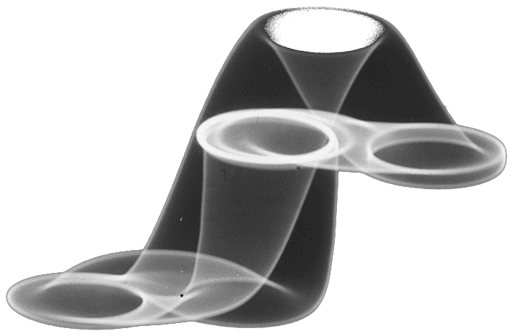



Computer graphics
Raster and vector graphics, graphic file formats, image editors, colors

Slide 27
Question
How many bites do you need for true color?
4
8
24
32

Slide 28
Answer
Before we only had one channel, where each pixel was 8 bits. Now, we have 3 channels, where each pixel has actually 24 bits (8 for red, 8 for green and 8 for blue). Some people call this 24 bit colour or true colour, but don’t confuse it with the fact that each channel is only represented by 8 bits. The range of colours than can be represented by 3X8 bit pixels is pretty enormous, in fact it gives you the possibility to have one of 16.7 million colours! Note the very subtle difference between bits per channel – 8 and bits per pixel – 24.
http://www.thewonderoflight.com/articles/bits-bytes/

Slide 29




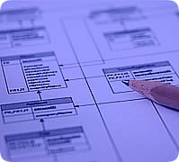

Data bases
Models of data, tables, relations, SQL

Slide 30
Question
Process of normalization of the database leads to:
Repeating information intables
Saving memory and improved performance
Unwanted data loss
Attributes that are independent on the primary key

Slide 31
Answer
Database normalization is the process of organizing the fields and tables of a relational database to minimize redundancy and dependency. Normalization usually involves dividing large tables into smaller (and less redundant) tables and defining relationships between them. The objective is to isolate data so that additions, deletions, and modifications of a field can be made in just one table and then propagated through the rest of the database using the defined relationships. Edgar F. Codd, the inventor of the relational model, introduced the concept of normalization and what we now know as the First Normal Form (1NF) in 1970. Codd went on to define the Second Normal Form (2NF) and Third Normal Form (3NF) in 1971, and Codd and Raymond F. Boyce defined the Boyce-Codd Normal Form (BCNF) in 1974.Informally, a relational database table is often described as "normalized" if it is in the Third Normal Form. Most 3NF tables are free of insertion, update, and deletion anomalies.
http://en.wikipedia.org/wiki/Relational_database
http://en.wikipedia.org/wiki/Database_normalization

Slide 32

Information architecture
ERP, CRM, BI, BPM, FMIS, CAD/CAM, CMS, софтуерни архитектури

Slide 33
Question
How many types of cloud are there according to their visibility?
2
3
4
5

Slide 34
Answer
A Public cloud is an IT infrastructure, platform or service, which is publicly available on the Internet (either free or paid). Public clouds are divided into three categories: IaaS, PaaS and SaaS.
IaaS (Infrastructure as a Service): This is a concept for a cloud, which gives virtual machines for rent. The tenant is able to install software by choice.
PaaS (Platform as a Service): This is a clouding technology family which gives an environment for developing as well as clouding services for software programmers with APIs.
SaaS (Software as s Service): This is a concept, in which software isn't installed locally, but it is rather used as a hosted service.
A Private cloud is an inside company clouding structure consisting of hardware and software which consolidates IT services for a single company or organization and is unaccessible for outside organizations.

Slide 35


Security and protection of information
Symmetrical and asymmetrical coding algorithms, cryptographic hash, digital signature, digital certificates

Slide 36

Question
Which of the following is NOT a symmetric encrypt or decrypt method?
AES
DES
3DES
DSA

Slide 37
Answer
http://en.wikipedia.org/wiki/Symmetric-key_algorithm
http://en.wikipedia.org/wiki/Public-key_cryptography

Slide 38




Presentation systems
Presentation software, preparation of presentations, slides, effects, notes, colors, images, sound, video

Slide 39
Question
The recommendedsize ofthe fontin a presentationshall be notless than:
20pt
22pt
24pt
26pt

Slide 40
Answer
The larger, the better. Remember, your slides must be readable from the back of the room. Content text should be no smaller than Verdana 24 point.
Use Sans Serif fonts such as Arial, Tahoma, and Veranda for clarity.
Do not use capitals except for occasional emphasis – they are harder to read than lower-case letters.
Do not mix fonts unless it is for a good reason, e.g., presenting quotes.
http://www.slideshare.net/PlusOrMinusZero/slide-presentation-guidelines
http://www.ashg.org/2013meeting/pages/abstract_powerpoint.shtml

Slide 41
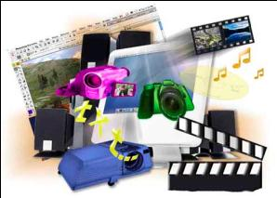
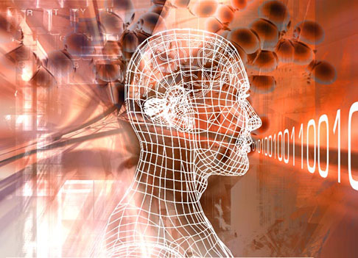
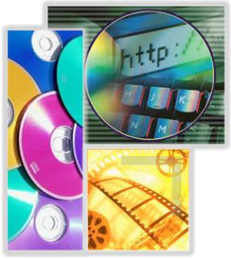

Мultimedia
Software creation / processing media: audio, video, file formats

Slide 42
Question
The .mkv file format is:
a video file consisting of audio and subtitles
a file consisting entirely of subtitles
a file consisting entirely of audio
a file which consists of a 3D format

Slide 43
Answer
MKV- Matroska video is a free multiplatform containering format. This file format can consist of an unlimited quantity of video and audio tracks with a big variety of used video and audio codes, subtitles and pictures, all of which in same file. It is similar to the formats AVI, MP4 and ASF. The difference between those and MKV is that MKV has open source code. MKV – a video file with audio and subtitles; MKA – entirely an audio file; MKS – entirely a subtitles file; MK3D - for video file containing 3D

Slide 44

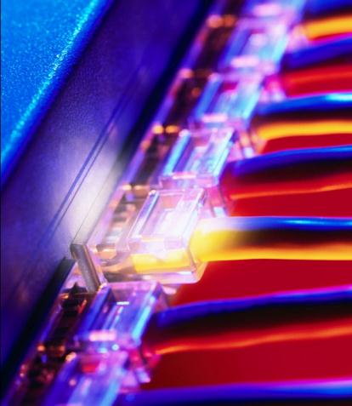
Computer networks
OSI model, network models, protocols, standards, hardware

Slide 45
Question
Which is NOT a computer network?
LAN
WAN
MAN
SSL

Slide 46
Answer
SSL (Secure Sockets Layer) is cryptographic protocol which is designed to provide communication security over the Internet.
All others LAN (Local Area Network), WAN (Wide Area Network), MAN (Metropolitan Area Network) are different types of computer networks. We can apply to them also WLAN (Wireless Local Area Network), PAN (Personal Area Network), SAN (Storage Area Network).
http://en.wikipedia.org/wiki/Computer_network
http://en.wikipedia.org/wiki/Secure_Sockets_Layer

Slide 47
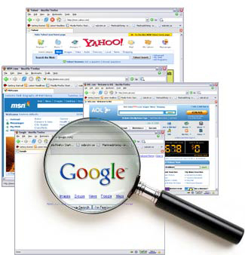


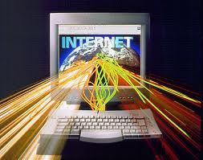
Structure of the Internet
Internet protocols, services, WWW, HTTP, FTP, SMTP, POP3, IMAP, WebDAV, IP, DNS, ...

Slide 48
Question
Which is the most used service on the Internet?
E-mail
File transfer
WWW
Online chat

Slide 49
Answer
The most used service on the Internet is the World Wide Web. The World Wide Web (abbreviated as WWW or W3, commonly known as the web) is a system of interlinked hypertext documents accessed via the Internet. With a web browser, one can view web pages that may contain text, images, videos, and other multimedia and navigate between them via hyperlinks.
http://en.wikipedia.org/wiki/WWW
http://simple.wikipedia.org/wiki/Internet

Slide 50


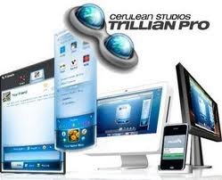

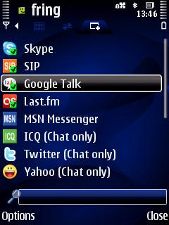
Electronic communication
E-mail, Skype, ICQ, IRC, MSN Messenger, Yahoo Messenger, social networks, forums, ...

Slide 51
Question
Which is an alternative to the POP3?
MAPI
IMAP
Webmail
Gmail

Slide 52
Answer
IMAP refers to Internet Message Access Protocol. It is an alternative to the POP3 email. With an IMAP account, a user's account has access to mail folders on the mail server and can use any compatible device to read messages, as long as such a device can access the server. It shows the headers of messages, the sender and the subject and the device needs to request to download specific messages. Usually mail is saved on a mail server, therefore it is safer and it is backed up on an email server.
http://en.wikipedia.org/wiki/E-mail#Types

Slide 53




World Wide Web (WWW)
How does WWW? Protocol HTTP, GET, POST, URL, web browser, web page, web site ...

Slide 54
Question
Which is the first web browser?
Netscape Navigator
Internet Explorer
Line Mode Browser
WorldWideWeb

Slide 55
Answer
A NeXT Computer was used by Berners-Lee as the world's first web server and also to write the first web browser, WorldWideWeb, in 1990. By Christmas 1990, Berners-Lee had built all the tools necessary for a working Web:^{[12]} the first web browser (which was a web editor as well); the first web server; and the first web pages,^{[13]} which described the project itself.
http://en.wikipedia.org/wiki/World_Wide_Web

Slide 56


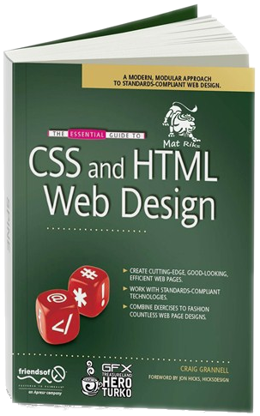

Web design, HTML, CSS
Web Design, HTML, CSS, text, graphics, links, tables, forms, ...

Slide 57
Question
Which HTML elements you use to control the appearance of the document contents?
Tags
Codas
Slashes
Properties
Code

Slide 58
Answer
In the HTML syntax, most elements are written with a start tag and an end tag, with the content in between. An HTML tag is composed of the name of the element, surrounded by angle brackets. An end tag also has a slash after the opening angle bracket, to distinguish it from the start tag. For example, a paragraph, which is represented by the p element, would be written as
<p>In the HTML syntax, most elements are written ...</p>

Slide 59





Scripting languages​​ JavaScript and
Development of scripts with JavaScript, basic JavaScript constructs, operators, objects, manipulation of DOM tree

Slide 60
Question
Which of the following is NOT a valid variable (or cannot be assigned with a value) in JavaScript 1.5?
$dollar
_�valid
Stringvariable
stringVariable
All are valid
All are wrong

Slide 61
Answer
JavaScript Variables:
As with algebra, JavaScript variables can be used to hold values (x=5) or expressions (z=x+y).
Variable can have short names (like x and y) or more descriptive names (age, sum, totalvolume).
Variable names must begin with a letter
Variable names can use Unicode letters (such as �)
Variable names can also begin with $ and _
Variable names are case sensitive (y and Y are different variables)
JavaScript is case-sensitive, which means it treats upper- and lowercase characters differently. For instance, JavaScript sees the following two variable identifiers as separate variables:
Variable namescannot be key/reserved words (for, break, if, else, case … int, bool, date, …)

